Slide 1
Census display modelling
Project Review
October 2016
Global Data science CPS method

Slide 2
Back ground
The project scope was to define an estimation of timing and define a path to orient research & model design…
After initial investigation, it became clear that there are opportunities to the predictive power of the model
Operational challenges.

Slide 3
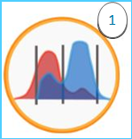
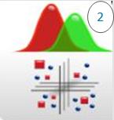
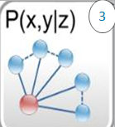
Exploration Phase: 3 main steps
New Predictive variables Definition
Display Promo Characterization
Modelling
Create new variables with high discriminate effect on Display Promo : optimal Discretization based on MDLPC algorithm
Display promo Characterization: explain the factors behind Display promo act purchases
Modeling: BAYES Predictive Model

Slide 4
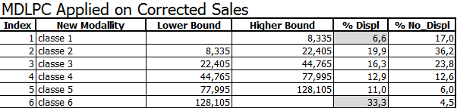
Why we use MDLPC Algorithm?
Problem statement
Target
Solutions & Results
No benchmark available to detect data change due to Promo effect based on classical data: Volume, value…
Conception of new variables with high discriminate effect on Display Promo
Supervised Re - coding using MDLPC Algorithm, based on the concept of entropy gain.
Optimal Discretization of continuous variables
New variables with high association to Display Promo
MDLPC Algorithm secure high correlation with Display Promo!

Slide 5
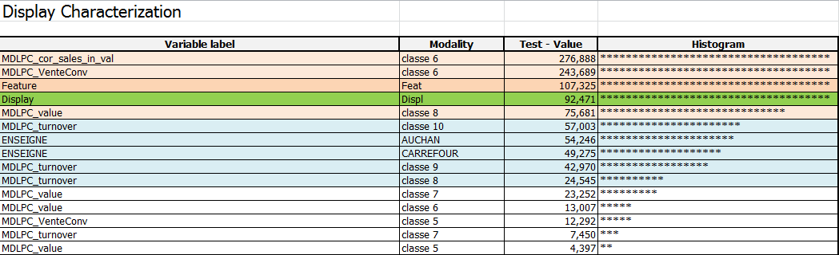
Explain factors behind Display promo act purchases ?
Problem statement
Target
Solutions & Results
As we are Leveraging a variety of data sources (Banners, store attributes, transformed data purchase facts - MDLPC …), It’s impossible to position the new set of variables compared to the existing ones.
Characterize the Display promo variable and explain the factors behind promo acts purchases…
Validate the contribution of each variables set and interactions
Multivariate analysis followed by hierarchical classification
Applied on potential predictive variables
The display promo variable is used as an illustrative variable
Output measure an indirect association between the promo/no promo and the significant criteria
Statistical test value allowed us to measure an indirect association between the promo/no promo and explain factors behind !

Slide 6
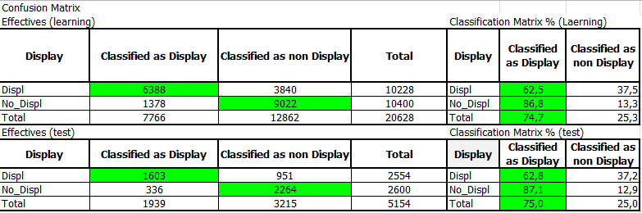

predictive models Result -Bayes Model-
Simple supervised classification model
H is the hypothesis to be tested H = { Display Promo }
E is linked evidence to hypothesis
Other models can be deployed: Logistic, PLS Logistic, neuronal network, Random Forest, SVM, Bagging…
The accuracy of the observation classified correctly 62% !!!
The model type will enhance significantly the accuracy

Slide 7
DATA SCIENCE methods RECOMMENDATION
Potential Solution
Keep current predictive variables based on static MDLPC’s thresholds
Thresholds should be defined by Retailer MBD & Category…
Operational feasibility to be checked – Deal with current process Flow –
Methods to enhance the model (Target more 85% of accuracy based on confusion matrix).
Drawbacks
Operational challenges

